Slide 1

Quine-Mc’Clusky’s and Moisil’s simplification methods

Slide 2
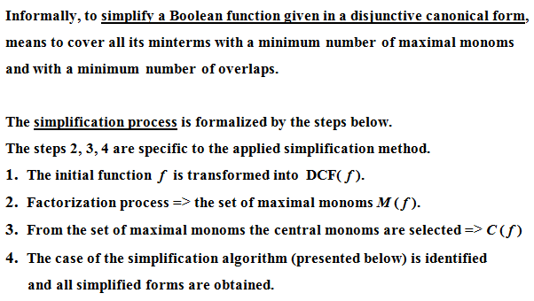

Slide 3
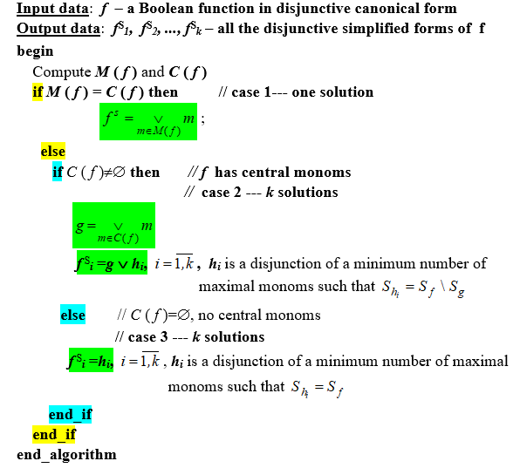
General
Simplification
Algorithm

Slide 4
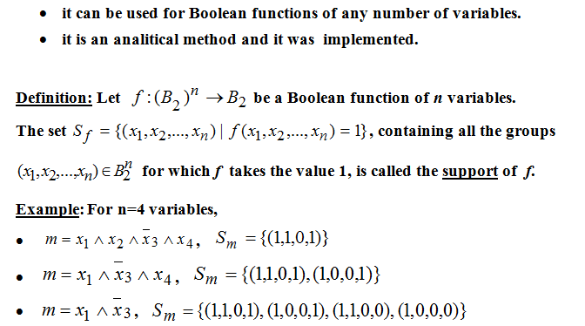
Quine’s method

Slide 5
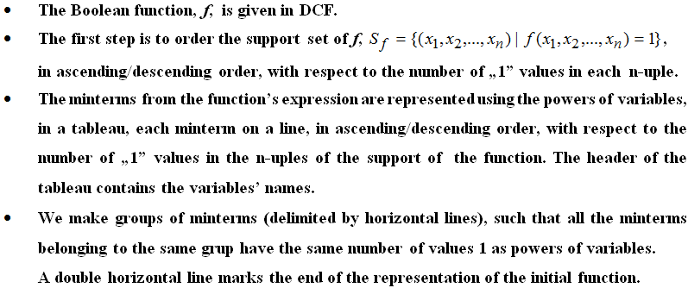
Quine’s Method –description (I)

Slide 6
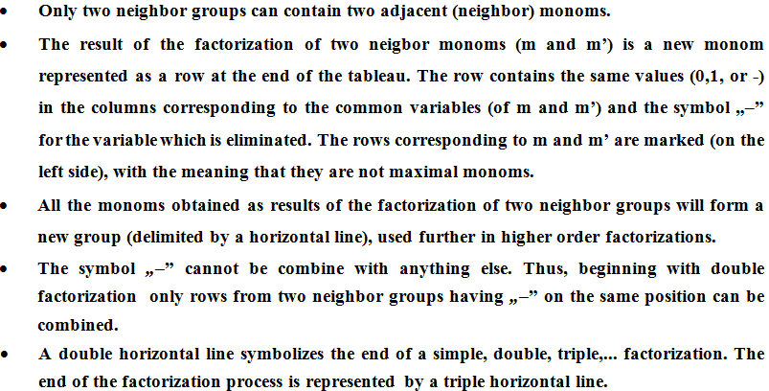
Quine’s Method –description (II)

Slide 7
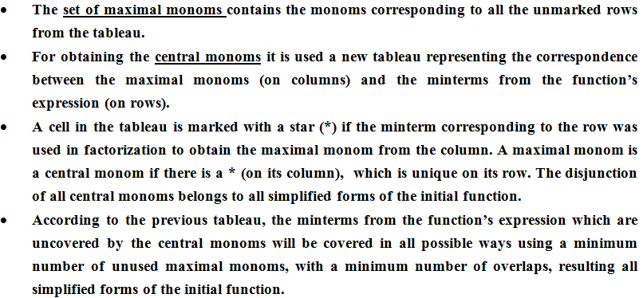
Quine’s Method –description (III)

Slide 8
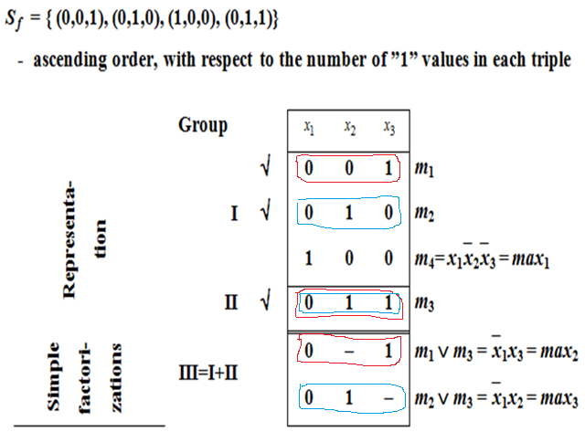
Example 1. Simplify the Boolean Function

Slide 9
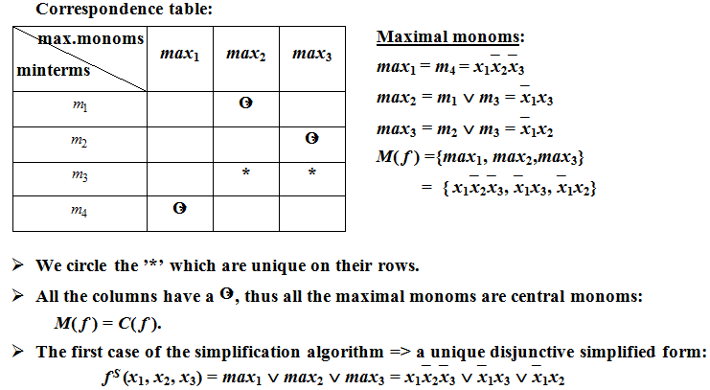
Example 1 (contd.)

Slide 10
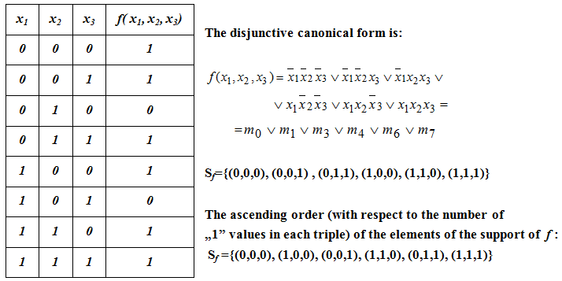
Example 2. Simplify the Boolean Function

Slide 11
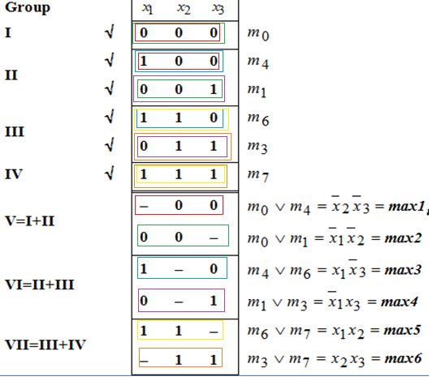
Example 2 – Factorization process

Slide 12
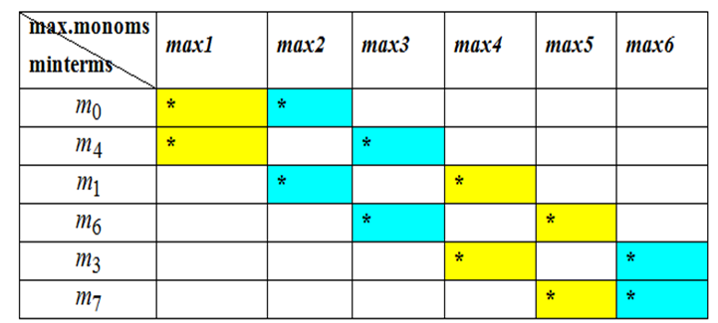



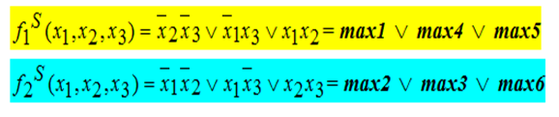
Example 2 (contd.)
Correspondence table:

Slide 13
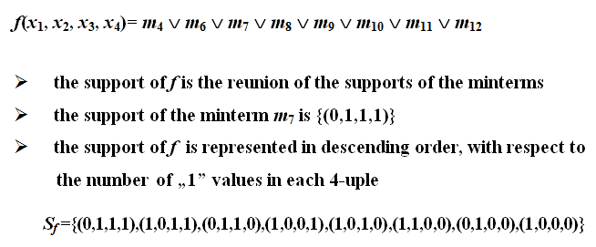
Example 3. Simplify the Boolean Function

Slide 14
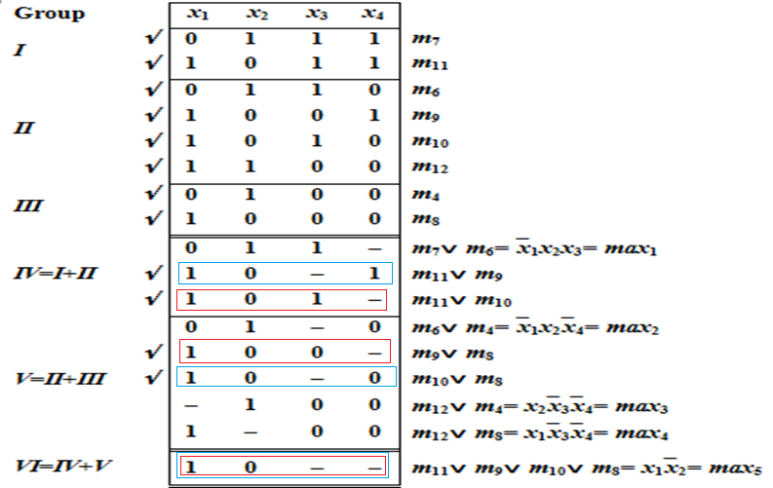
Example 3 – Factorization process

Slide 15
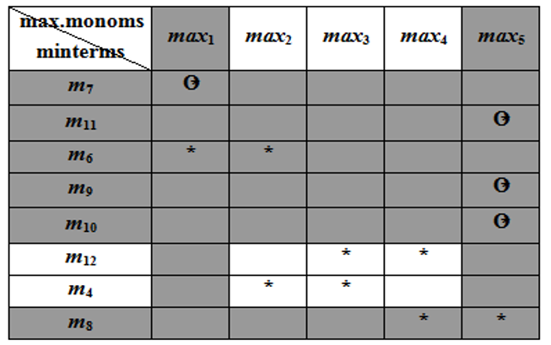


Example 3 – Central monoms
Correspondence table:

Slide 16
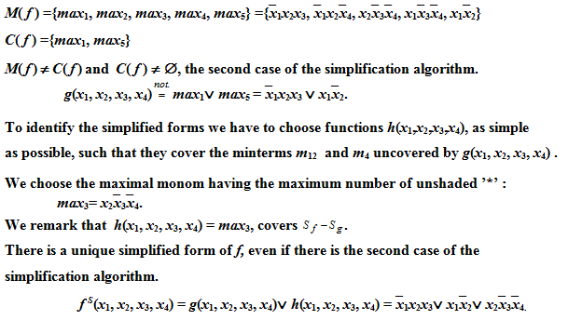
Example 3 – simplified forms

Slide 17
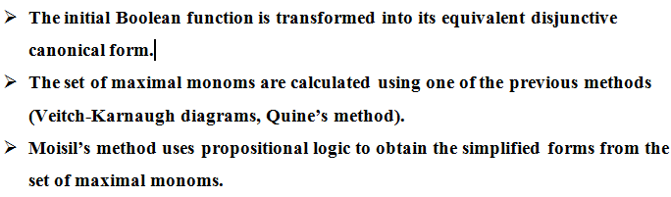
Moisil’s simplification method

Slide 18
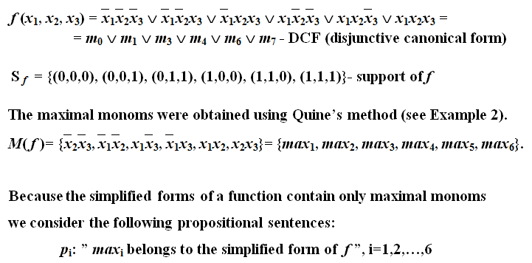
Example 4. Simplify the Boolean Function

Slide 19

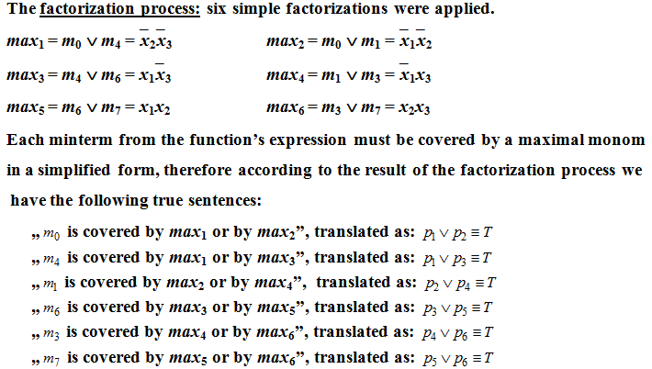
Example 4 (contd.)

Slide 20
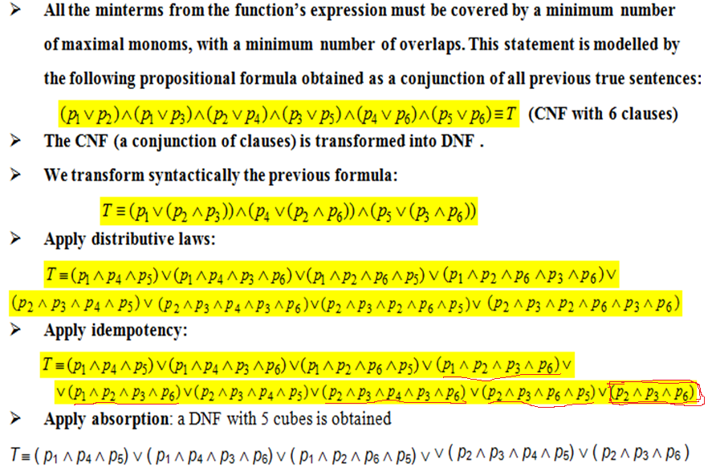
Example 4 (contd.)

Slide 21
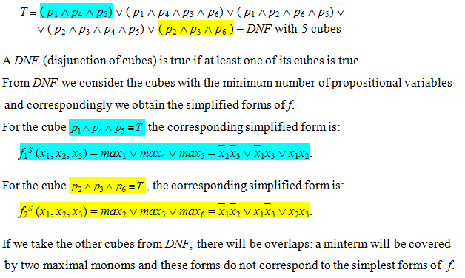
Example 4 (contd.)

Slide 22


